Slide 1
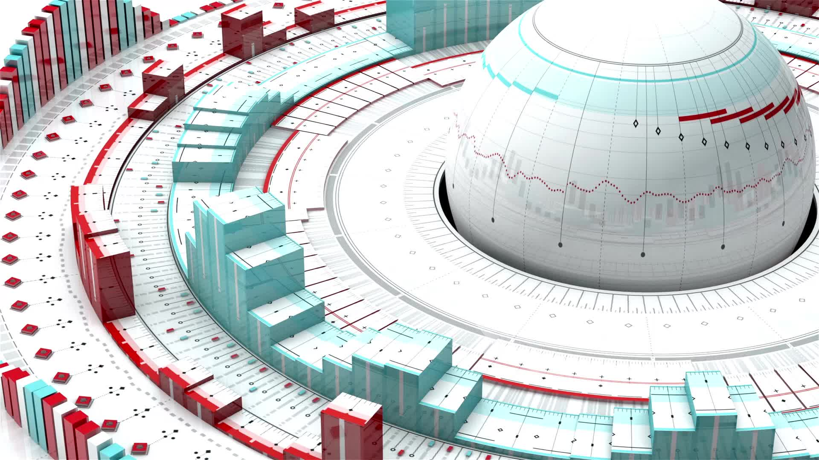
How To create a computer vision custom dataset?
A brief research

Slide 2

Open Images
In this presentation, we will walk through how to make our own custom Open Images dataset.

Slide 3
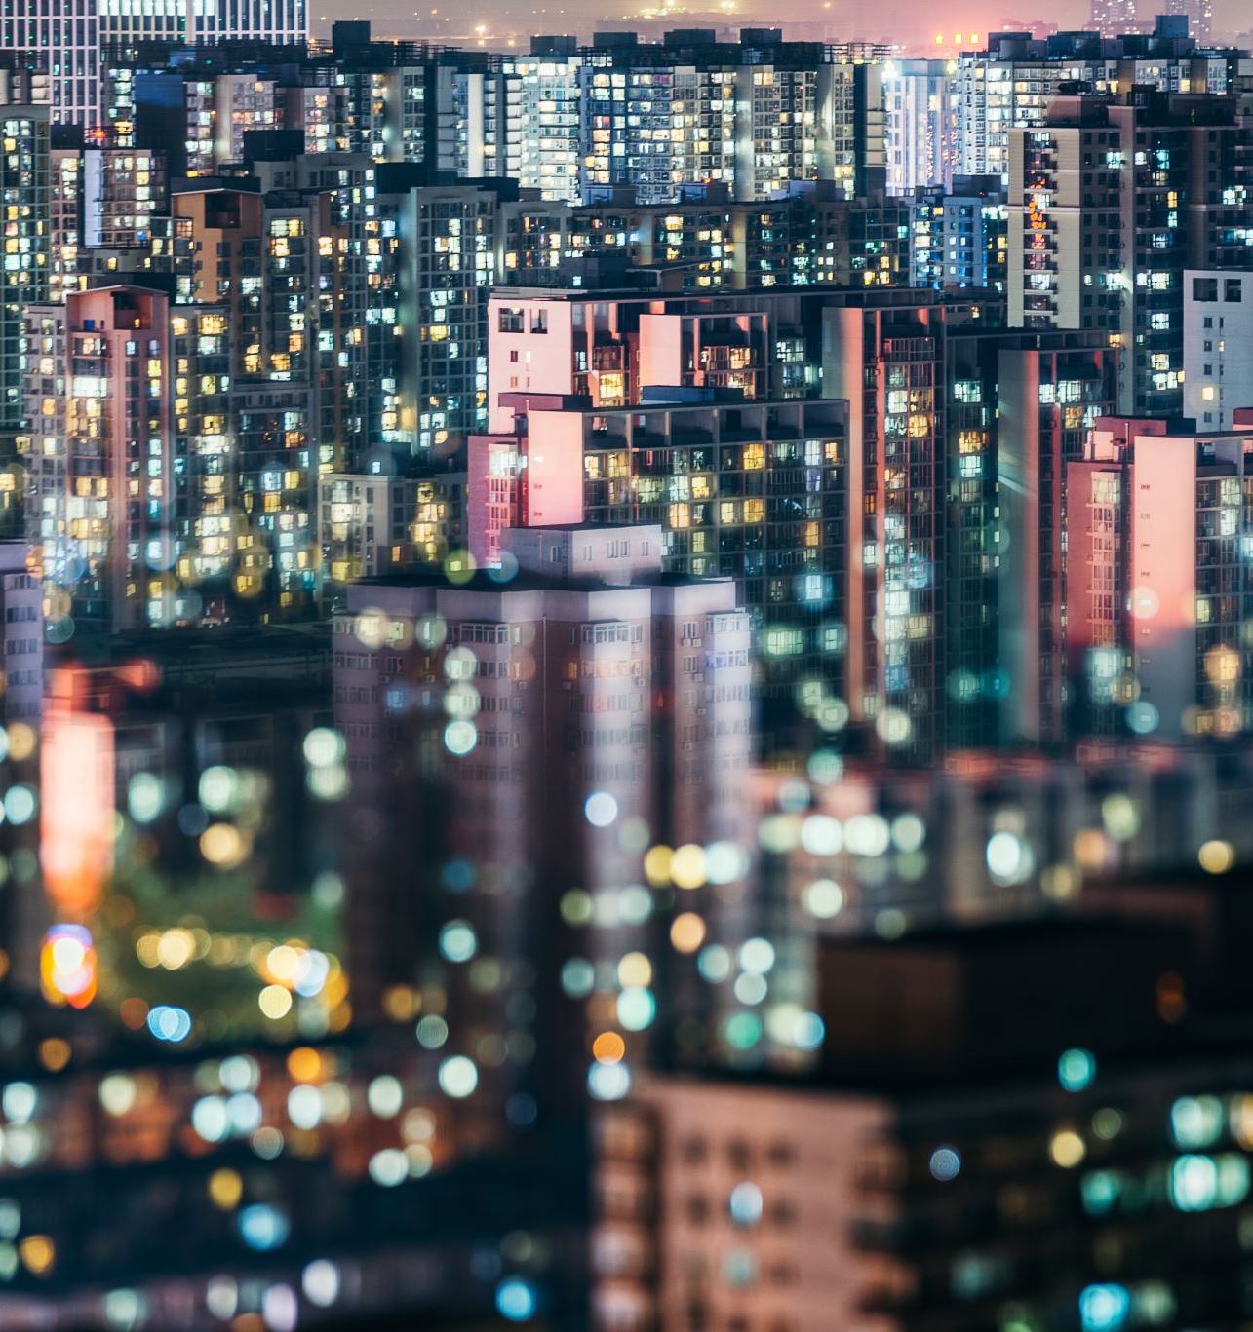
Open Images
Vehicles are just a small window into the vast landscape of the Open Images dataset and are meant to provide small examples of datasets that one could construct with Open Images.

Slide 4
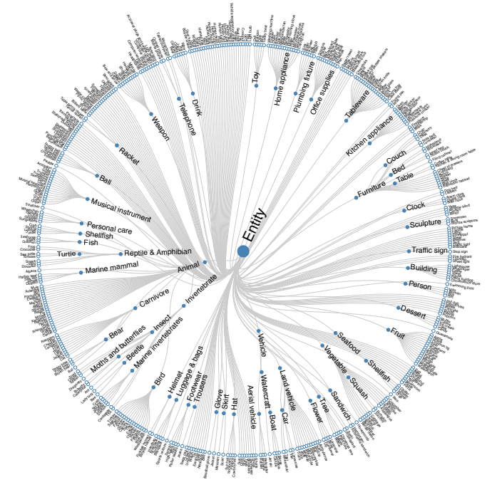
The vast array of subdomains in the Open Images Dataset

Slide 5
About Open Images
Open Images is an open-source computer vision detection dataset released by Google.
The dataset contains a vast amount of data spanning image classification, object detection, and visual relationship detection across millions of images and bounding box annotations.
The Open Image dataset provides a widespread and large-scale ground truth for computer vision research.

Slide 6
Why Create A Custom Images Dataset?
Experiment with creating a custom object detector
Assess feasibility of detecting similar objects before collecting and labeling our own data
Augmenting and existing training set
Training a custom detector model checkpoint to apply to a more niche custom task where you have less data
And of course, for fun 😁

Slide 7
Downloading 200 labeled lobsters from Open Images:
python3 main.py downloader -y --classes Lobster --Dataset Lobster --type_csv train --image_IsGroupOf 0 --n_threads 4 --limit 200

Slide 8
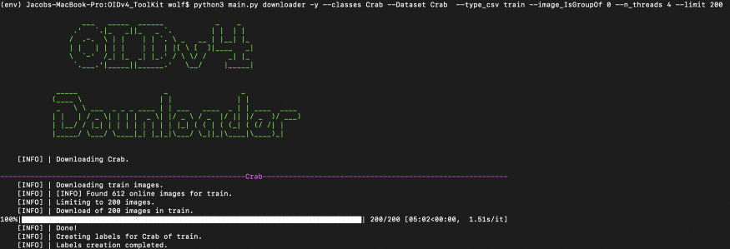

Slide 9
Converting Open Images Annotation Formats
In order to convert our annotations into any format, you simply make a free account with Roboflow and drag our images into the data upload flow.

Slide 10
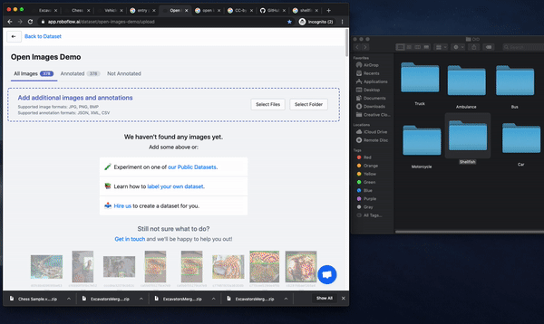

Slide 11
Exporting
Once our dataset is created, we will be able to export in any format you desire. To name a few we will be able to:
Convert Open Images to Coco Json
Convert Open Images to Pascal Voc XML
Convert Open Images to Create ML Json
Convert Open Images to YOLO Darknet
Convert Open Images to Amazon Sage Maker
Convert Open Images to Amazon Rekognition
Convert Open Images to TFRecord
Convert Open Images to YOLO Darknet
Convert Open Images to YOLOv5 Pytorch

Slide 12

Introducing my Roboflow’s Public Custom Open Images Dataset

Slide 13
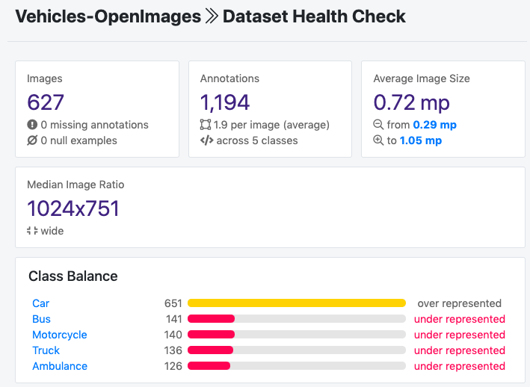

Slide 14
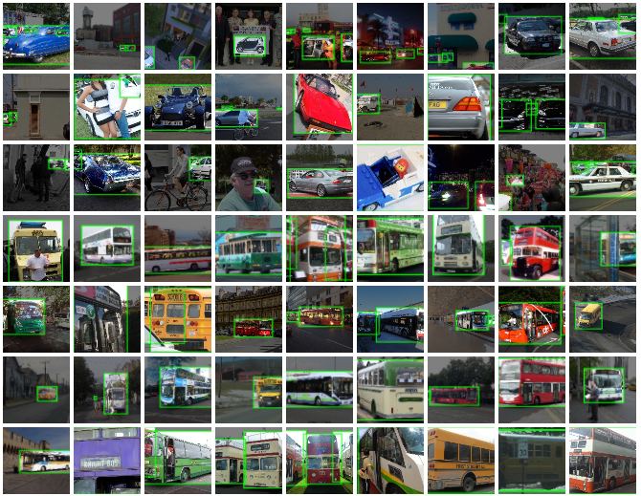

Slide 15
Conclusion
Now we know how to construct a custom Open Images dataset using completely free computer vision data and open-source tools.

